Slide 1
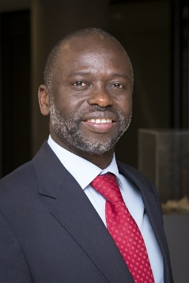
Wits University
11 September 2018
Divinatory computation : The Politics of Artificial Intelligence
Professor Tshilidzi Marwala
Vice Chancellor and Principal, University of Johannesburg, Republic of South Africa

Slide 2

Artificial Intelligence, Machine Learning and Deep Learning
Artificial Intelligence
Machine Learning
Soft Computing
Deep Learning
Computational Intelligence
Big Data = Using AI to analyze large amount of data
Professor Tshilidzi Marwala l University of Johannesburg

Slide 3
Soft Computing: Bluff and Detect Bluffing (Fraud detection)
Fuzzy Logic, Multi-Agent System, Mechanism Design
Professor Tshilidzi Marwala l University of Johannesburg

Slide 4


Computational Intelligence: Ant Colony Optimization
Professor Tshilidzi Marwala l University of Johannesburg

Slide 5
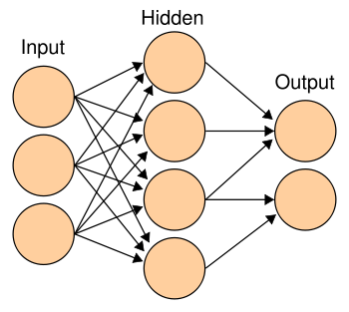
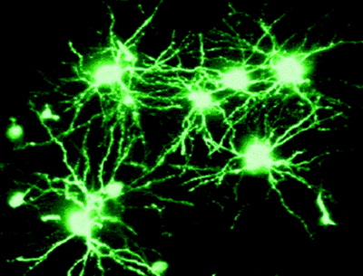
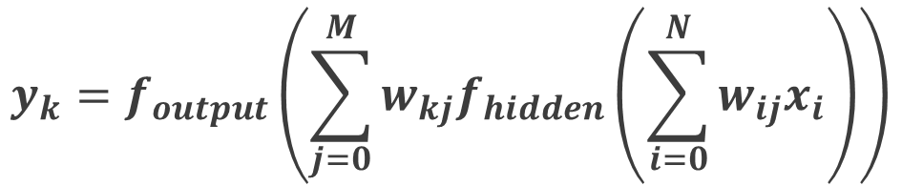
Machine Learning: Statistical Approach to AI
Neural Networks = Generalized regression modelling
$$y_{k}=f_{output}\left(\sum_{j=0}^{M}{w_{kj}f_{hidden}\left(\sum_{i=0}^{N}{w_{ij}x_{i}}\right)}\right)$$
Professor Tshilidzi Marwala l University of Johannesburg

Slide 6
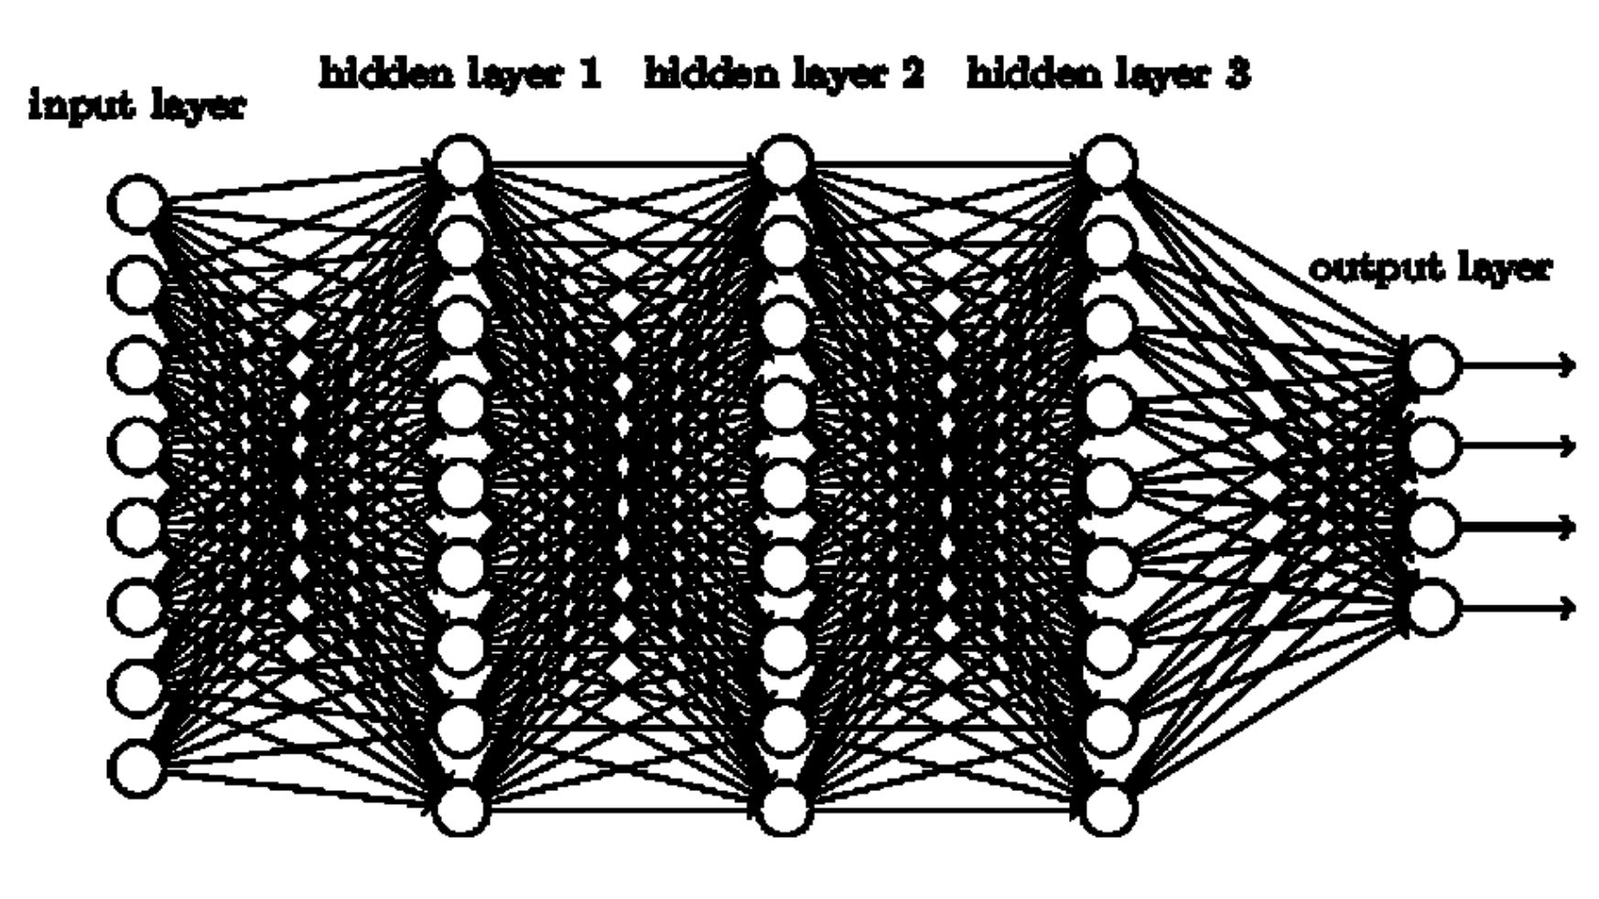

Deep Learning
Professor Tshilidzi Marwala l University of Johannesburg

Slide 7
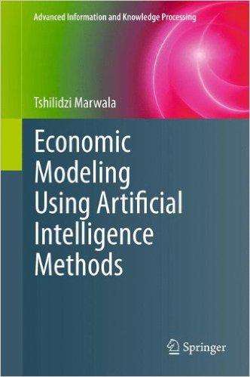
Artificial Intelligence and Economics
Demand and Supply
Rational Expectations and Rational Choice
Bounded Rationality and Behavioral Economics
Game Theory and Mechanism Design
Causality and Counterfactuals
Pricing and Portfolio Theory
Professor Tshilidzi Marwala l University of Johannesburg

Slide 8
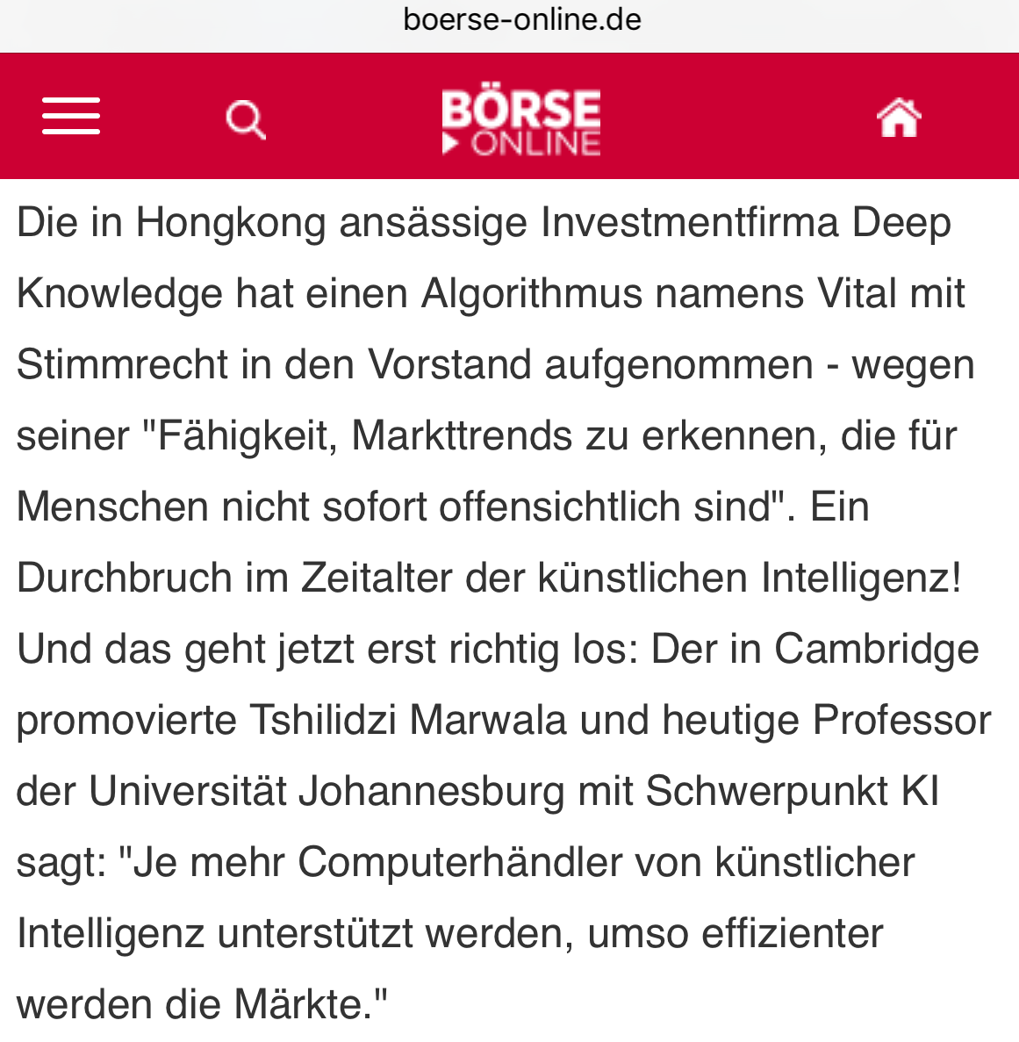
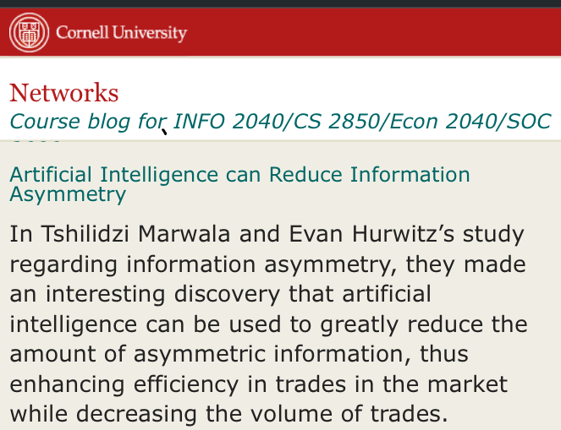
Information Asymmetry and Market Efficiency
Professor Tshilidzi Marwala l University of Johannesburg

Slide 9

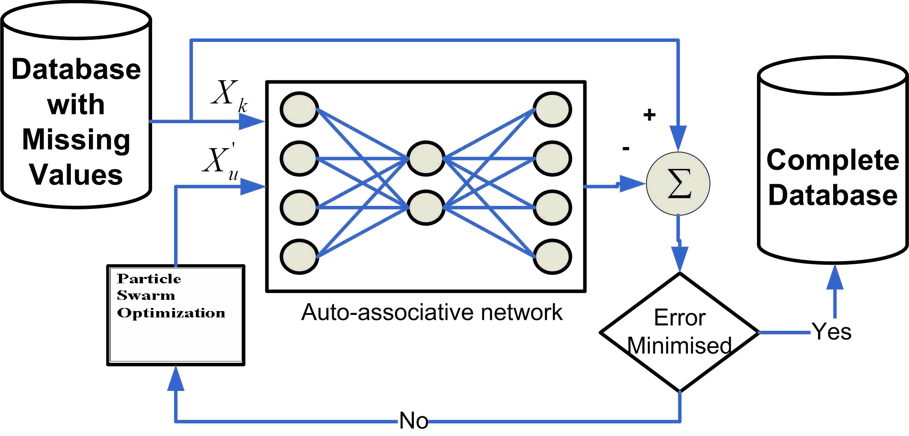
Decision Making with Incomplete/Imperfect Information:
Prediction of HIV Risk
Professor Tshilidzi Marwala l University of Johannesburg

Slide 10
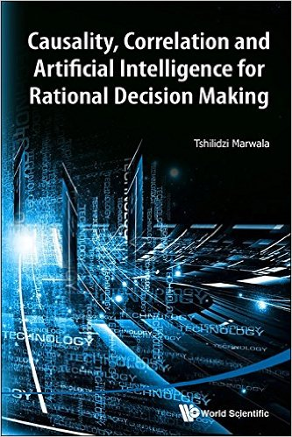
Making Rational/Bounded-Rational Decisions
Causality: Granger Causality, Co-integration, Do-Calculus
Factual and Counterfactuals
Counterfactuals and Causality
Correlation versus Causality
Causality, Correlation, Counterfactuals and Clinical Trials
Professor Tshilidzi Marwala l University of Johannesburg

Slide 11


Political Science: Interstate conflict
Professor Tshilidzi Marwala l University of Johannesburg

Slide 12
The psychology Human-Robots Interaction
Professor Tshilidzi Marwala l University of Johannesburg

Slide 13
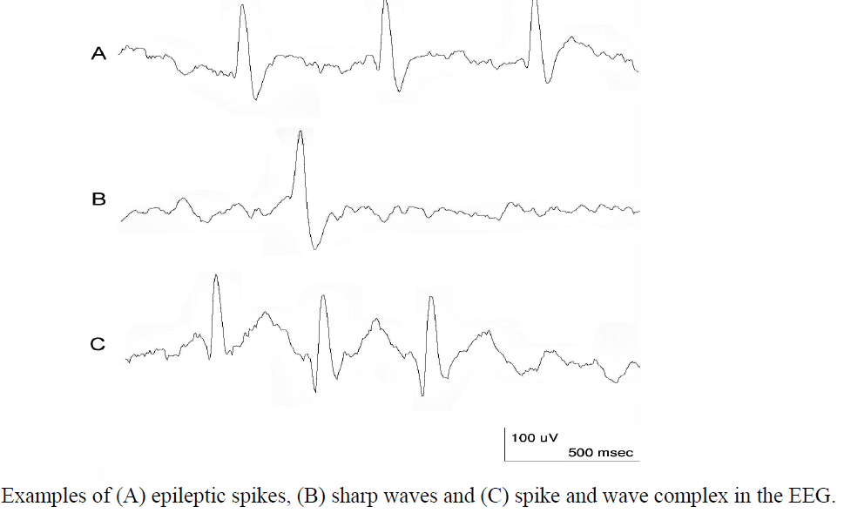
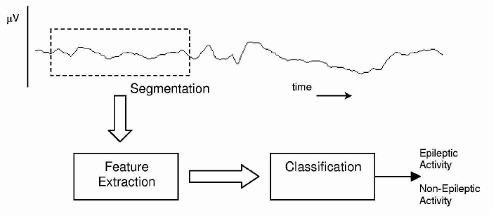
Medical Application: Detection of epilepsy
Professor Tshilidzi Marwala l University of Johannesburg

Slide 14
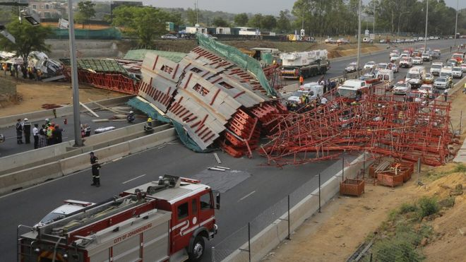

Monitoring the condition of structures
Professor Tshilidzi Marwala l University of Johannesburg

Slide 15
Ethics: Recognizing African faces and voices
Professor Tshilidzi Marwala l University of Johannesburg

Slide 16
Consequences of advances in artificial intelligence
Post-work era
Universal basic income
Taxing robots
Irrelevance versus exploitation
Increase inequality
Bounded freedom (we are being watched)
Bounded decision making by humans
Bounded nationalism
Laws to regulate automation
Ethics to govern automation
Human-Robot interaction will create new psychology of people

Slide 17
Thank you…

